Slide 1



AKHIL BHARATIYA MARATHA SHIKSHAN PARISHAD'S ANANTRAO PAWAR COLLEGE OF ENGINEERING & RESEARCH PUNE
“Smart AI Based Solutions and Services For Businesses”
Presented By
Name Roll No.
Aneksha Ravindra Bhosale(4403)
Pranali Gopinath Randhe (4401)
Rohan Rajkumar Tekale (4417)
Rushikesh Dnyandeo shinde(4416)
Project Guide:- Prof. Snehal Veer
Department of Electronics and Telecommunication Engineering
Academic year 2022-2023

Slide 2

Contents
Literature Survey
Library management
Recommendation System
Feedback System​
Robotic Arm
System Overview
Results
References
Conclusion

Slide 3
Literature Survey
Sr.No | Title of Paper | Name of the Journal/Conference | Key finding
1 | “EMG Controlled Bionic Robotic Arm using Artificial Intelligence and Machine Learning” | 2020 IEEE Region 10 Symposium (TENSYMP), 5-7 June 2020, Dhaka, Bangladesh | The research proposes the use of various machine learning algorithms for gesture recognition. These algorithms are trained on sEMG recordings collected from hand muscles.
2 | “Designing and Developing a Chatbot Using Machine Learning” | 2020 9th International Congress on Advanced Applied Informatics (IIAI-AAI) | In this they used deep learning algorithms provide a powerful framework for learning and extracting knowledge from large and complex datasets, enabling machines to make accurate predictions, classifications, and generate valuable insights.
3 | “AI and Web-Based Human-Like Interactive University Chatbot (UNIBOT)” | Proceedings of the 2019 Third International Conference on Electronics Communication and Aerospace Technology. | In this paper is chatbot is developed using PHP programming language, which is commonly used for web development and can easily integrate with existing websites.

Slide 4
Sr.No | Title of Paper | Name of the Journal/Conference | Key finding
4 | “Smart College Chatbot Using Ml and Python” | 2020 Institute of Electrical and Electronics Engineers [IEEE] | In this project we studied to made a college specific chatbot system that can be custom fitted to education domain chatbot
5 | “An Intelligent Web App Chatbot” | 2020 International Conference on Smart Technologies in Computing, Electrical and Electronics. | In this paper, they used Microsoft Cloud service platform along with its machine learning AI is used for building the bot.
6 | “A Platform for Human- Chatbot Interaction Using Python” | 2018 Institute of Electrical and Electronics Engineers [IEEE] | In this paper we studied the analysis of different chatbots and create our own client using python and web-based applications
7 | “Enhancing College Chat Bot Assistant with the Help of Richer Human Computer Interaction and Speech Recognition” | 2020 International Conference on Electronics and Sustainable Communication Systems | In this paper ,User can provide the feedback by pressing like and dislike buttons based on the replied received to their query.

Slide 5
Sr.No | Title of Paper | Name of the Journal/Conference | Key finding
8 | “Enhancing College Chat Bot Assistant with the Help of Richer Human Computer Interaction and Speech Recognition” | 2020 International Conference on Electronics and Sustainable Communication Systems | To check the accuracy of chatbot, same query has been asked in different form by changing the wordings of sentences and appending various especial characters and irrelevant words.
9 | “An AI-Based Methodology for the Automatic Classification of a Multiclass E-book Collection Using Information from the Tables of Contents” | 2020 Institute of Electrical and Electronics Engineers [IEEE] | In this paper, we investigated the use of an unsupervised NN (SOM) and two DNN architectures to assess the classi cation performances of the methods in a multiclass setting.
10 | “Book Recommendation System with TensorFlow” | 2021 7th International Conference on Advanced Computing & Communication Systems (ICACCS) | In this paper we have to add tensorflow techniques to make a recommendation system stable and recommend the relevant kind of books to the user in the efficient and simple manner.
11 | “Construction of Smart Library System Based on Book Information Retrieval” | Proceedings of the Fifth International Conference on Intelligent Computing and Control Systems (ICICCS 2021) | They used three methods: APP, WeChat Official Account and WeChat Mini Program as the entrance to the mobile smart library

Slide 6
Sr.No | Title of Paper | Name of the Journal/Conference | Key finding
12 | “A Collaborative Filtering Based Library Book Recommendation System” | 2018 5th International Conference on Business and Industrial Research (ICBIR), Bangkok, Thailand | They conducted a recommendation experiment using the collaborative filtering. Book borrowing records with time stamps are used to construct rating matrix
13 | “Construction of Smart Library System Based on Book Information Retrieval” | date of publication June 26, 2019 | In this paper, texture and the local information entropy are used to joint ly reflect regional compactness information
14 | “A Survey on Sentiment Analysis” | 2021 International conference of cloud computing, Data science and Engineering) | In this paper survey done on sentiment Algorithm
11 | “Sentiment Analysis using Machine Learning and Deep Learning” | 2020 IEEE | In this paper ,tweet data is collected and then passed.

Slide 7

Library Management
Book Recommendation
System
Sentimental
Analysis
Chat-Bot
Android controlled Robotic Arm

Slide 8
Recommendation System
Display Top 5 Books
Start
Databases-book.csv,ratings.csv,users.csv
Recommender Systems-Collaborative Filtering Based, Popularity Based
Programming Languages- Python, HTML
Tools & Libraries- JupyterNotebook , Numpy , Pandas, pickle
Web Interface
Import
Python Libraries
Filtering Method
Upload
Databases
Data Preprocessing

Slide 9
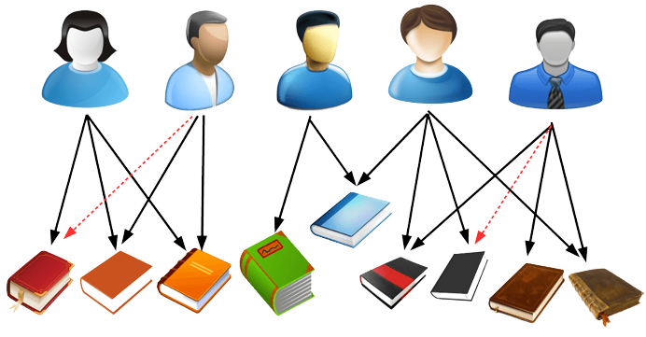
Recommendation
Recommendation System
Customer’s Interest
Ratings
Best Pick

Slide 10

Feedback System
Sentiments
Upload databases
Databases-book.csv,ratings.csv,users.csv
Programming Languages- Python
Tools & Libraries- Pandas,Matplotlib,TensorFlow
Web interface
Data Preprocessing
Train The Model
Build the Text Classifier

Slide 11
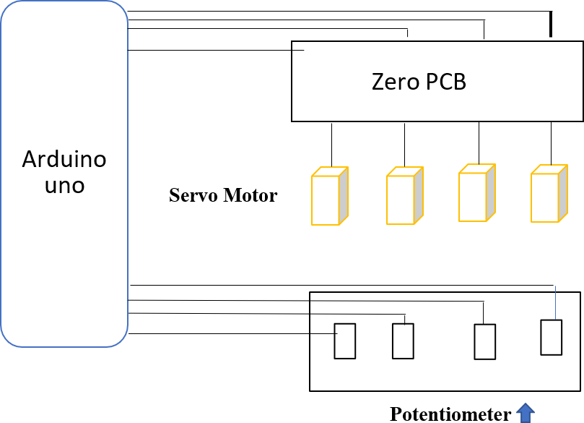
Robotic Arm

Slide 12
Robotic Car
Dc motor 1
Dc motor2
Arduino Uno
Hc 05 Bluetooth Model
Motor Controlled shield for Arduino
Battery
Dc motor 3
Dc motor 4

Slide 13

Robotic Arm
Microcontroller-Arduino Uno
Programming Languages- C/C++
Tools & Libraries- Arduino IDE

Slide 14

Chat-Bot System
Start
User Input
Understanding the response
Matching The Best Probability
Testing The Long Response
Simplifies The Response creation
Counts Words in predefined message
Calculate the percent of recognized word

Slide 15

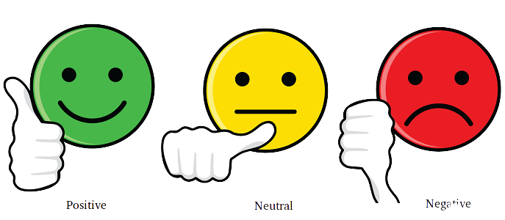



SYSTEM OVERVIEW

Slide 16
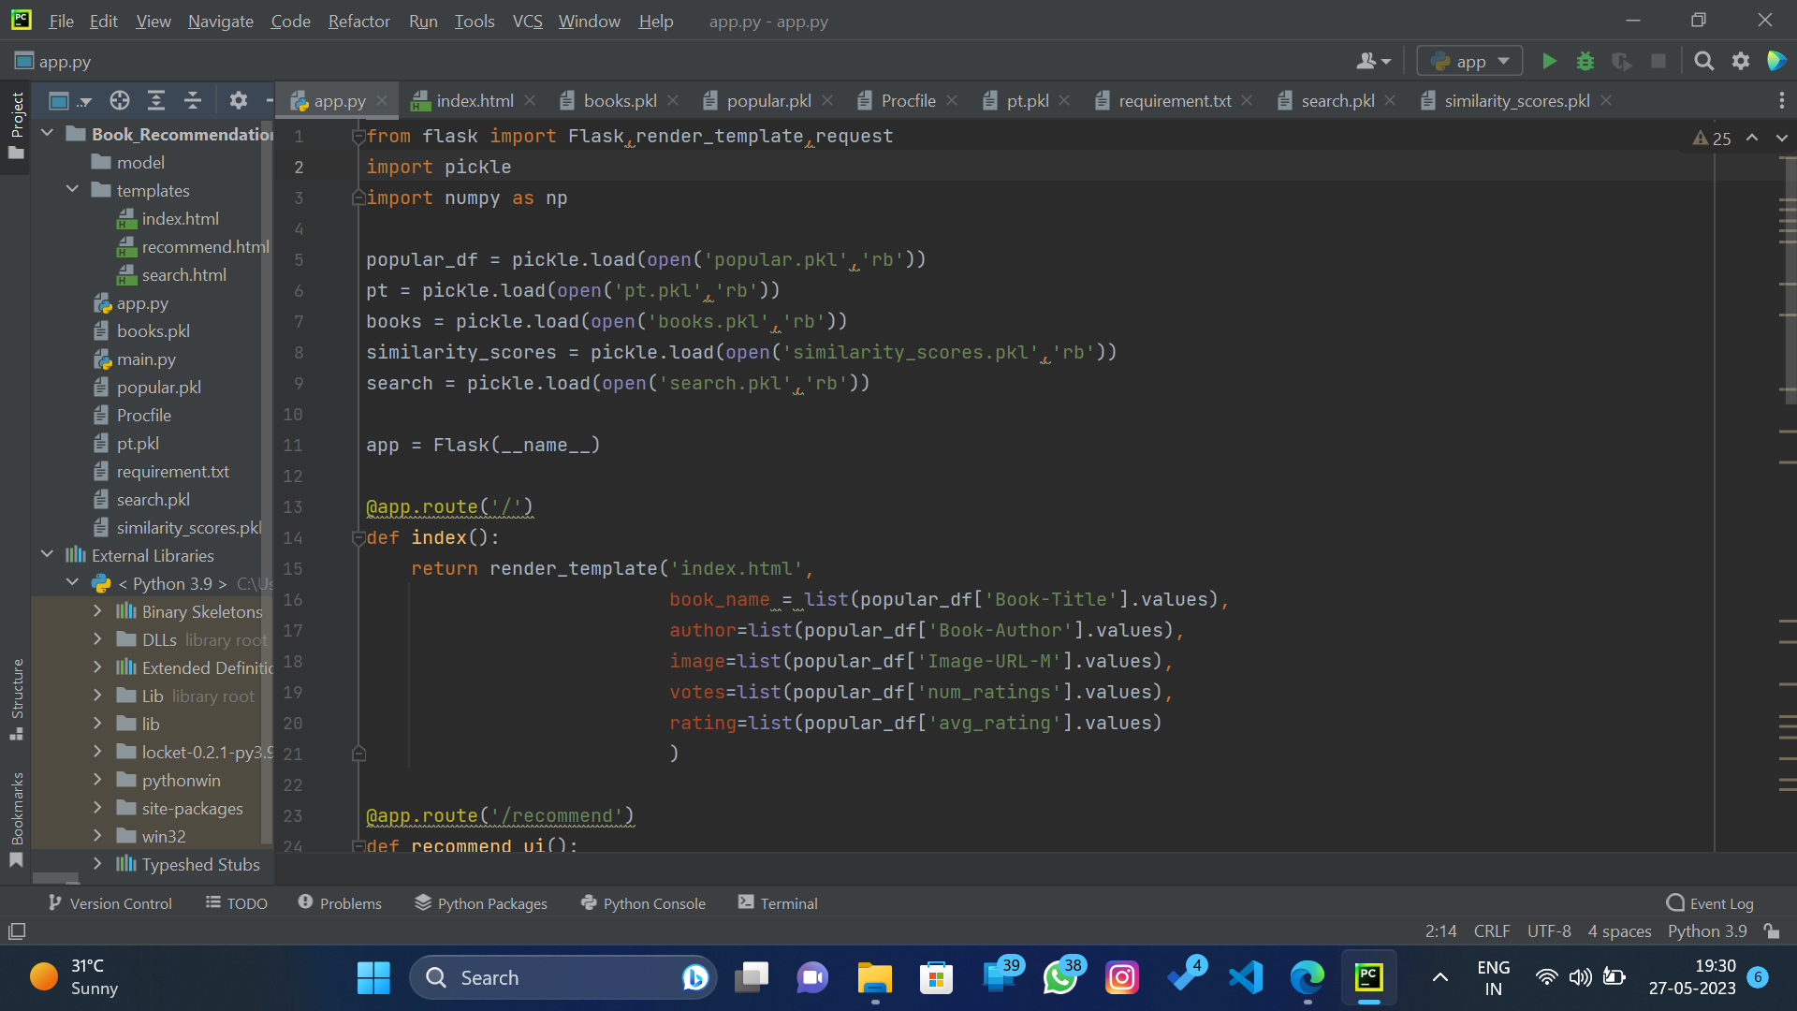
The Coding Part…..

Slide 17
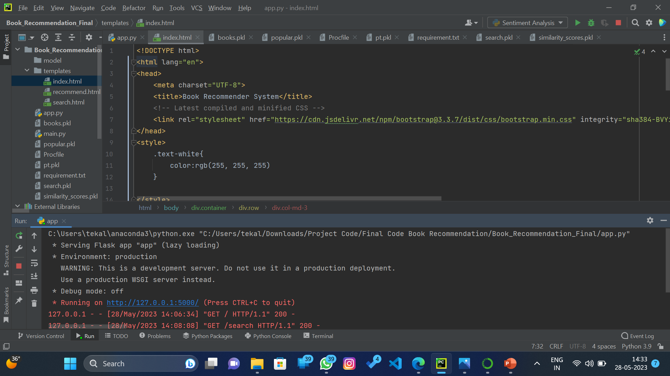

Slide 18
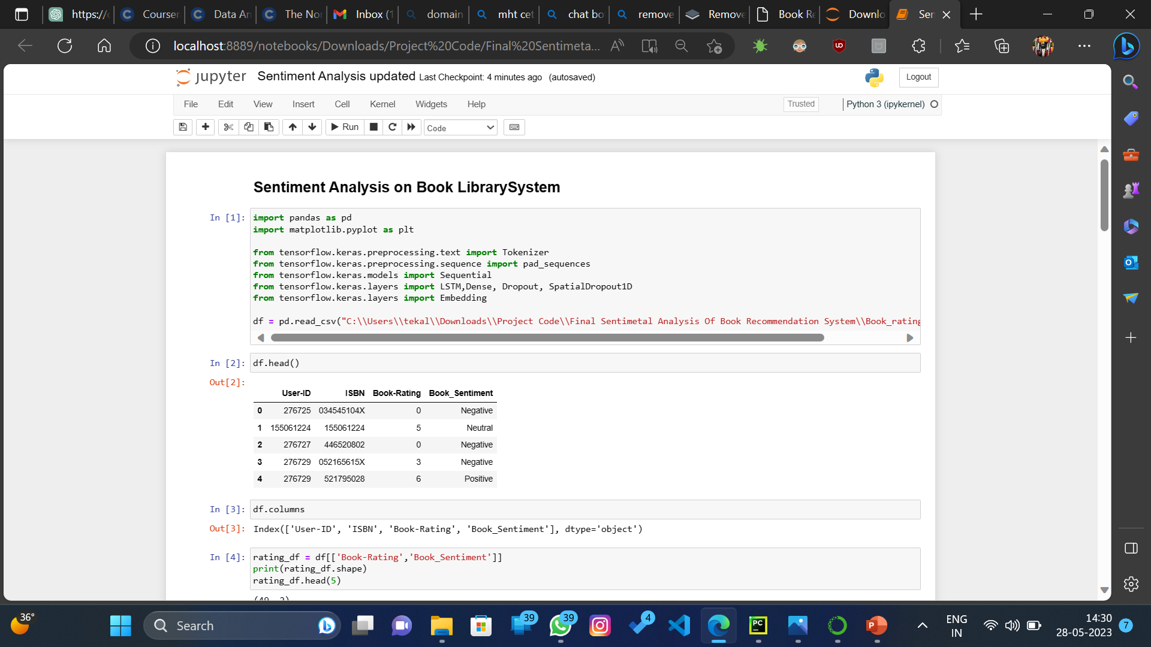

Slide 19
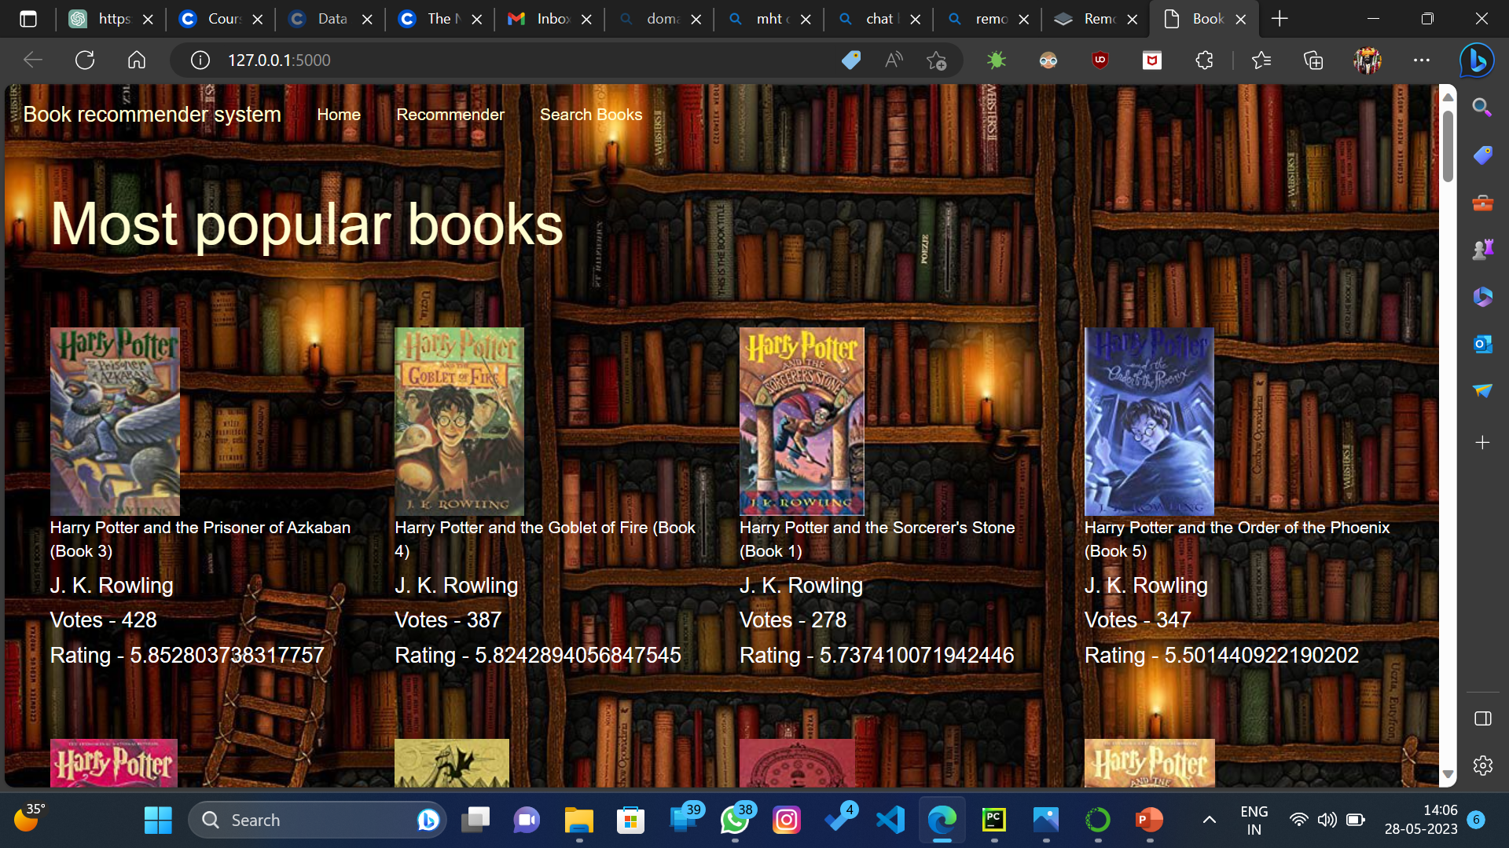
Results

Slide 20


Slide 21
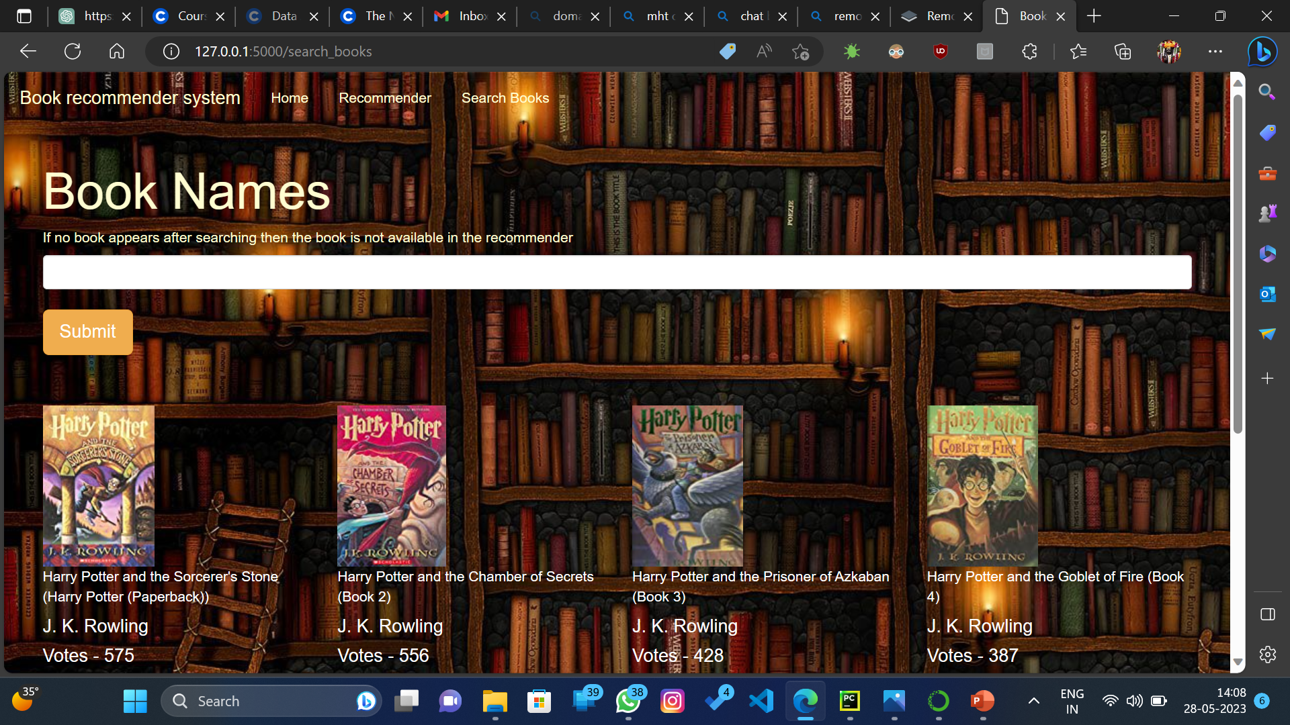

Slide 22
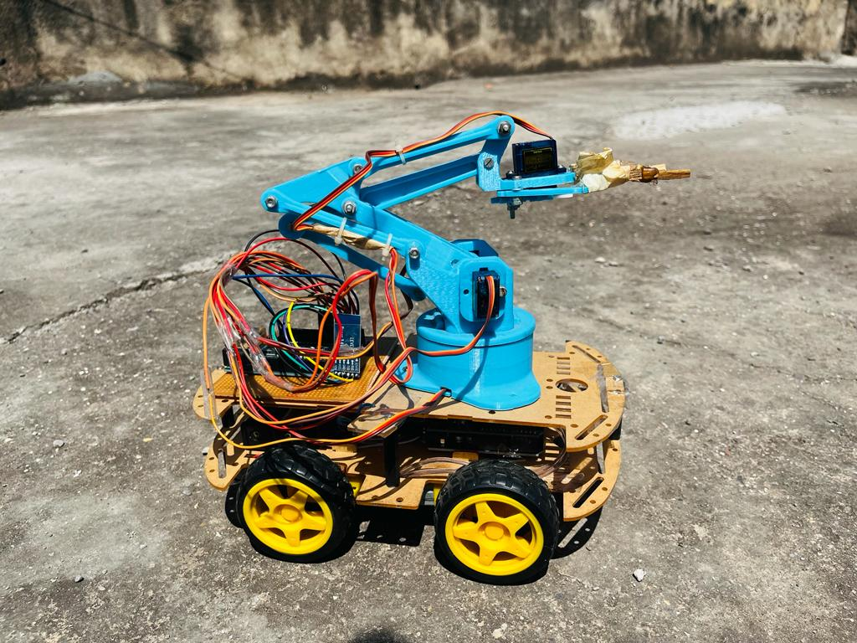

Slide 23
References
1] Farhan Fuad Rupom, Shafaitul Jannat, Farjana Ferdousi Tamanna, Md. Motaharul, “EMG
Controlled Bionic Robotic Arm using Artificial Intelligence and Machine Learning”, 2020 IEEE
Region 10 Symposium (TENSYMP), 5-7 June 2020, Dhaka, Bangladesh.
2] Praveen Kumar, Mayank Sharma, Seema Rawat, Tanupriya Choudhury, “Designing and
Developing a Chatbot Using Machine Learning”,2018 International Conference on System
Modeling & Advancement in Research Trends
3] Neelkumar P. Patel1, Devangi R. Parikh, Prof. Darshan A. Patel, Prof. Ronak R. Patel, “AI
and Web-Based Human-Like Interactive University Chatbot (UNIBOT),” Proceedings of the
2019 Third International Conference on Electronics Communication and Aerospace
Technology.
4] Shaziya Banu , Shantala Devi Patil, “An Intelligent Web App Chatbot” , 2020 International
Conference on Smart Technologies in Computing, Electrical and Electronics.
5] Hrushikesh Koundinya K, Ajay Krishna Palakurthi, Vaishnavi Putnala, Dr. Ashok Kumar
K, “Smart College Chatbot Using Ml and Python”, 2020 Institute of Electrical and Electronics
Engineers [IEEE].

Slide 24
6] Bhaumik Kohli, Shilpi Sharma, Praveen Kumar, “A Platform for Human- Chatbot Interaction
Using Python”, 2018 Institute of Electrical and Electronics Engineers [IEEE].
7] Sangeeta Kumari, Zaid Naikwadi, Akshay Akole, Purushottam Darshankar , “Enhancing
College Chat Bot Assistant with the Help of Richer Human Computer Interaction and Speech
Recognition”, 2020 International Conference on Electronics and Sustainable Communication
Systems.
8] Satyendra Praneel Reddy Karri, Dr.B.Santhosh Kumar, “Enhancing College Chat Bot
Assistant with the Help of Richer Human Computer Interaction and Speech Recognition”, 2020
International Conference on Electronics and Sustainable Communication Systems.
9] Eleni Giannopoulou, Nikolas Mitrou, “An AI-Based Methodology for the Automatic
Classification of a Multiclass E-book Collection Using Information from the Tables of
Contents”, 2020 Institute of Electrical and Electronics Engineers [IEEE].
10] Anandaraj A, Yeshwanth Ram P, Sri Ram Kumar K, Revanth M, Praveen R, “Book
Recommendation System with TensorFlow”, 2021 7th International Conference on Advanced
Computing & Communication Systems (ICACCS).
11] Chaloemphon Sirikayon, Panita Thusaranon, Piyalak Pongtawevirat, “A Collaborative
Filtering Based Library Book Recommendation System”,2018 5th International Conference on
Business and Industrial Research (ICBIR), Bangkok, Thailand.

Slide 25
12] Yongjie Zhang,“Construction of Smart Library System Based on Book Information
Retrieval”,Proceedings of the Fifth International Conference on Intelligent Computing and
Control Systems (ICICCS 2021).
13] Ruijun Liu, Yuqian Shi, Changjiang, Ming Jia ,“Construction of Smart Library System
Based on Book Information Retrieval”,date of publication June 26, 2019
14] Yogesh Chandra, Antoreep Jana,“Sentiment Analysis using Machine Learning and Deep
Learning”,2020 IEEE

Slide 26
Conclusion
In Library System, Our main Customer’s are readers & we deliver Smart AI-based College Library System which optimizes the library experience, making it more personalized, efficient, and user-friendly. By harnessing the power of AI, sentiment analysis, and robotics, this system transforms the traditional library into a technologically advanced hub of knowledge, offering enhanced book recommendations, convenient interactions, and streamlined operations.

Slide 27
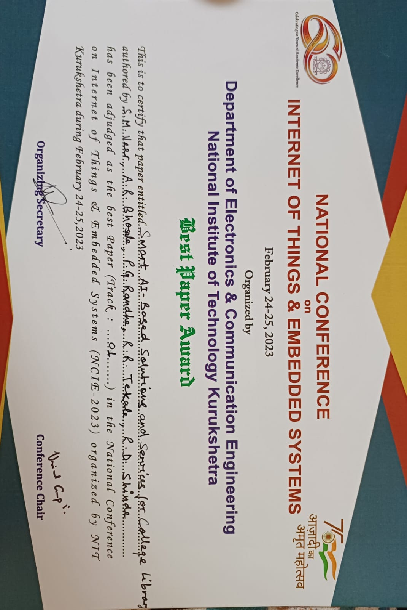

Our Achievements..

Slide 28
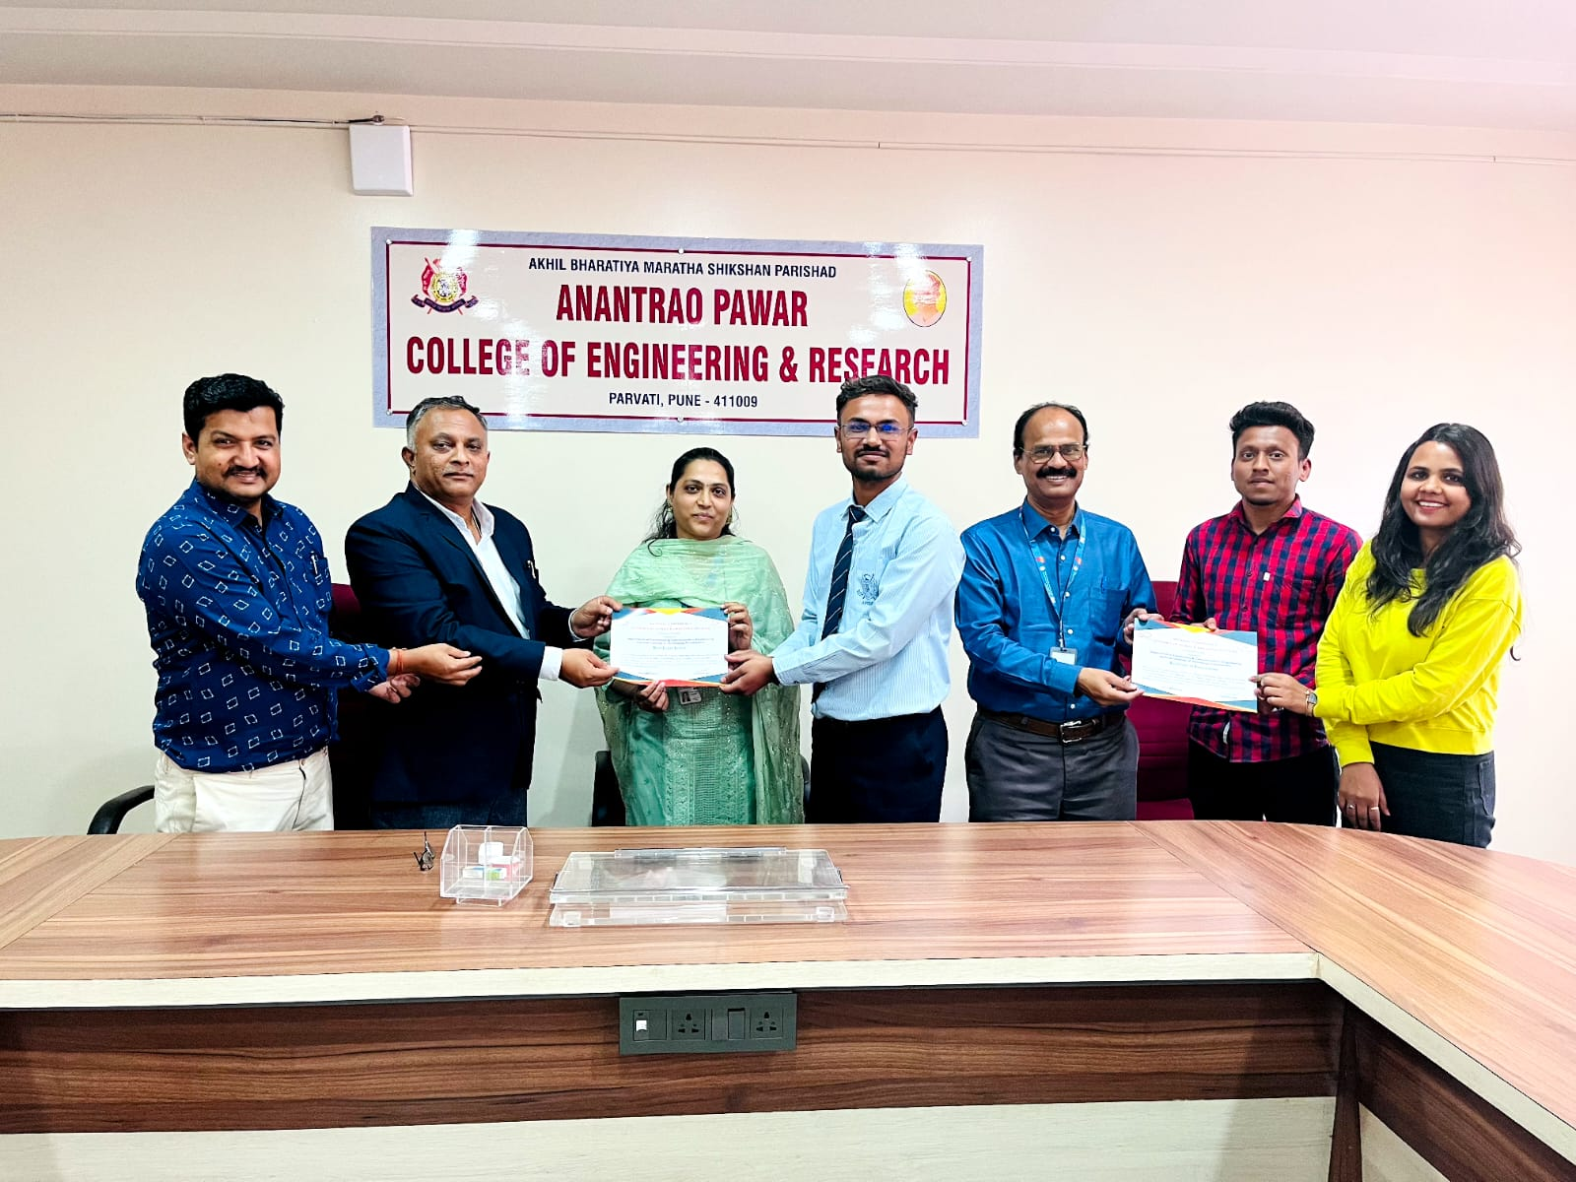

Slide 29


